Slide 1
Ripple Protocol Consensus Algorithm

Slide 2
Introduction
Existing Byzantine Fault Tolerance algorithms are subjected to high latency as network communicates synchronously.
Application of this protocol allows minimal connectivity to maintain agreement, resulting is reduced latency to reach consensus in cases of Byzantine failures.

Slide 3
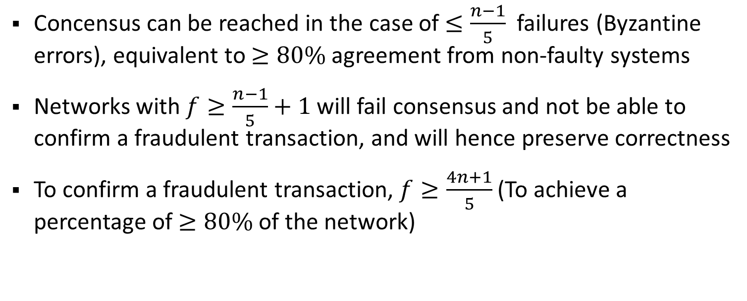
Proposition
Concensus can be reached in the case of $≤\frac{n−1}{5}$ failures (Byzantine errors), equivalent to $≥80\%$ agreement from non-faulty systems
Networks with $f≥\frac{n−1}{5}+1$ will fail consensus and not be able to confirm a fraudulent transaction, and will hence preserve correctness
To confirm a fraudulent transaction, $f≥\frac{4n+1}{5}$ (To achieve a percentage of $≥80\%$ of the network)
Notes:
Correctness is the maximal amount of Byzantine failures such that a fraudulent transaction will never be confirmed

Slide 4

Terminologies & Methods
Unique Node List (UNL): Each server $s$ maintains a unique node list which $s$ queries (other servers) to determine concensus.
This assumes that there is a level of trust that the server is not faulty (in the distributed network).

Slide 5
Representations
If this node exhibits Byzantine failure and votes against the system, then all nodes in that clique will fork the chain since there is a single point of failure
Adding another node on the other clique on this node’s UNL will allow the clique to maintain consensus
- Normal nodes
- Faulty nodes
Notes:
Unique Node List, maintains the list of nodes to connect to determine consensus

Slide 6
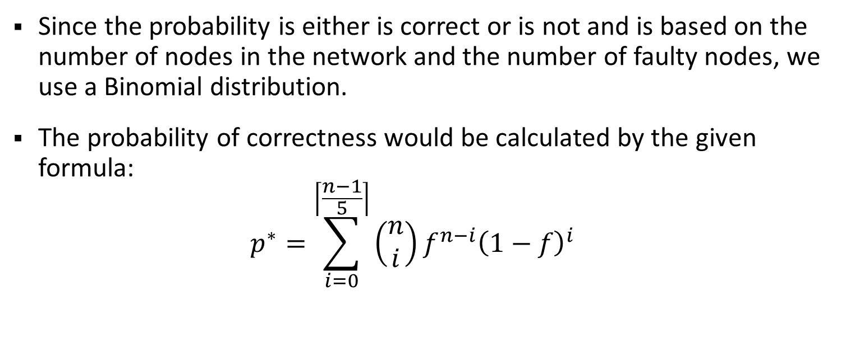
Calculations on Correctness (Consensus)
Since the probability is either is correct or is not and is based on the number of nodes in the network and the number of faulty nodes, we use a Binomial distribution.
The probability of correctness would be calculated by the given formula: $p^{∗}=\sum_{i=0}^{\left\lceil \frac{n−1}{5}\right\rceil }{\left(\begin{matrix}n \\ i\end{matrix}\right)}f^{n−i}{\left(1−f\right)}^{i}$

Slide 7
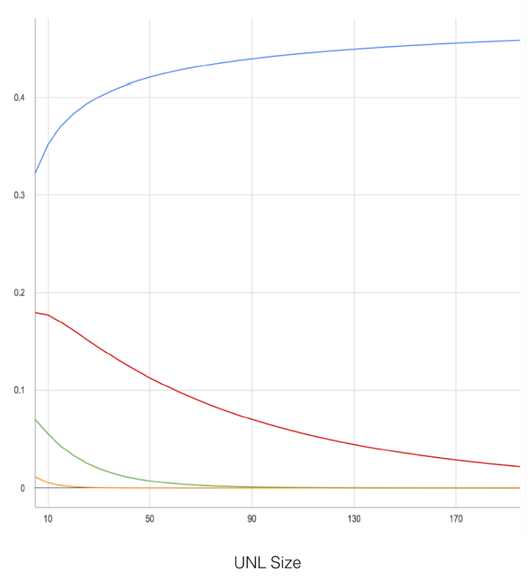





Proof of Correctness
$$f=20\%$$
$$f=15\%$$
$$f=10\%$$
$$f=5\%$$
We notice that as the UNL size increases, even at 20% Byzantine error, voting by these faulty systems never constitute more than half of the entire network.
If it is 15% or less, then increasing the UNL size will significantly decrease the probability of not obtaining consensus.

Slide 8
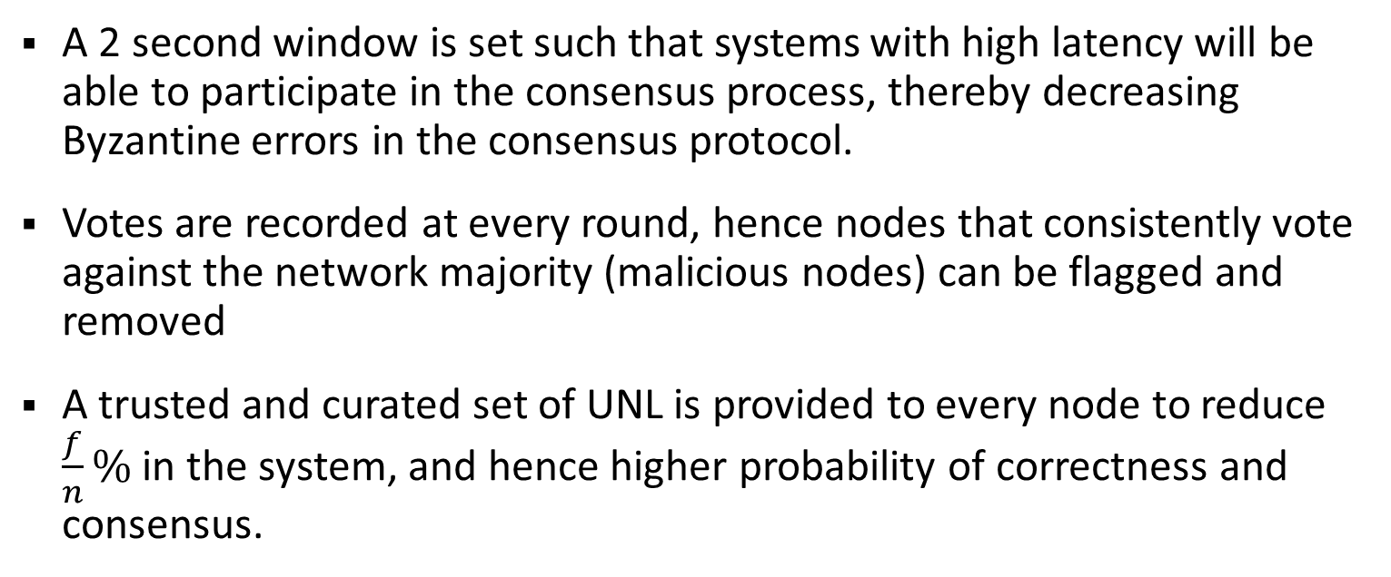
Procedure
A 2 second window is set such that systems with high latency will be able to participate in the consensus process, thereby decreasing Byzantine errors in the consensus protocol.
Votes are recorded at every round, hence nodes that consistently vote against the network majority (malicious nodes) can be flagged and removed
A trusted and curated set of UNL is provided to every node to reduce $\frac{f}{n}\%$ in the system, and hence higher probability of correctness and consensus.
Notes:
f/n%: percentage of byzantine nodes in the system

Slide 9
Procedure
A network split detection algorithm is also implemented to detect if the size of the UNL suddenly decreases due to poor network connectivity and sudden forks in the network. This will indicate to the nodes to not process or vote on transactions but still participating in the consensus process
Reapplying this protocol multiple times to obtain multiple rounds of consensus allows detection of nodes bottlenecking the system. This allows for gradual increase of consensus to eventually hit 80%

